Slide 1
CORPORATE SUMMARY
October 15, 2019

Slide 2
Disclaimer
This presentation may contain “forward-looking information” within the broad meaning of your country’s securities legislation, which are based on the opinions and estimates of management and are subject to a variety of risks and uncertainties and other factors that could cause actual events or results to differ materially from those projected in the forward-looking information. Such risks and uncertainties include, but are not limited to, risks associated with the mining industry, the risk of commodity price and foreign exchange rate fluctuations, the ability of Farafina Gold Group (“FGG”) to fund capital and operating expenses necessary to achieve the business objectives of FGG, as well as political risks. Due to the risks, uncertainties and assumptions inherent in forward-looking information, prospective investors in securities of FGG should not place undue reliance on this forward-looking information.

Slide 3
Farafina Gold Group owns five exploration and mining licenses in the Republic of Guinea Consolidated recoverable resources are estimated at 2 million ounces of gold

Slide 4
With the dedicated efforts of our multinational team and a sophisticated approach to exploration, Farafina Gold Group has already captured
first-mover advantage in several gold-rich properties in the Republic of Guinea.
Ilya Karas, Chairman

Slide 5
Farafina Gold Group highlights
Mineral reserves conservatively valued at $90 million (at $300 / oz gold) as at June 30, 2019
Management objective is to certify indicated reserves of no less than 2 million oz. (50 tons) by 2022
Consolidated assets projected to reach $1.2 - $1.5 bln within the same timeframe

Slide 6
Mineral resources
Current
As of June 30, 2019, the Group mineral reserves are valued at 2 tons ($90 mm, €77 mm)
Approximately 4% of exploitable gold resources
Approximately 1.5-2% of total mineral reserves
Projected

Slide 7
Group companies and licenses
License holder | Lions Head Resources Guinea (SARL) |  | Kanguela Mining Company SARL | Tiger Resources SARL | Farafina Resources SARL
Number and duration of license | 2015/3717 dd 24.07.2015, 3 years | 2018/270 dd 2018, 5 years* | 2017/012 dd 13.01.2017, 3 years | 2017/011 dd 13.01.2017, 3 years | 2016/6293 dd 2016, 3 years
Licensed site name | Paramangui | Kangouela East (Wodokodoni) | Kangouela West | Faralako North | Faralako South (Nzima)
Area, km2 | 63 | 52.12 | 52,12 | 43,93 | 44
* Semi-industrial mining license

Slide 8
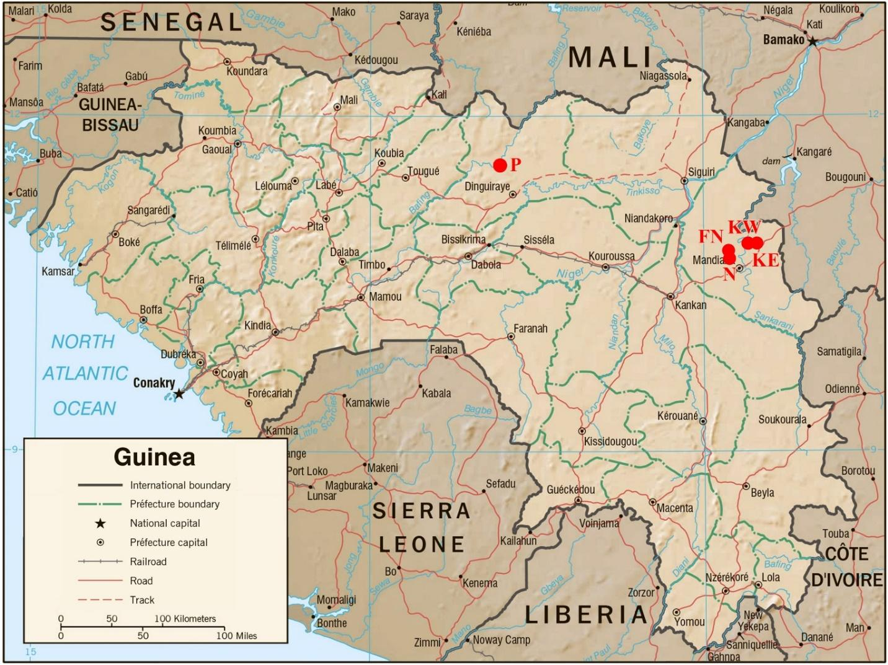

Slide 9
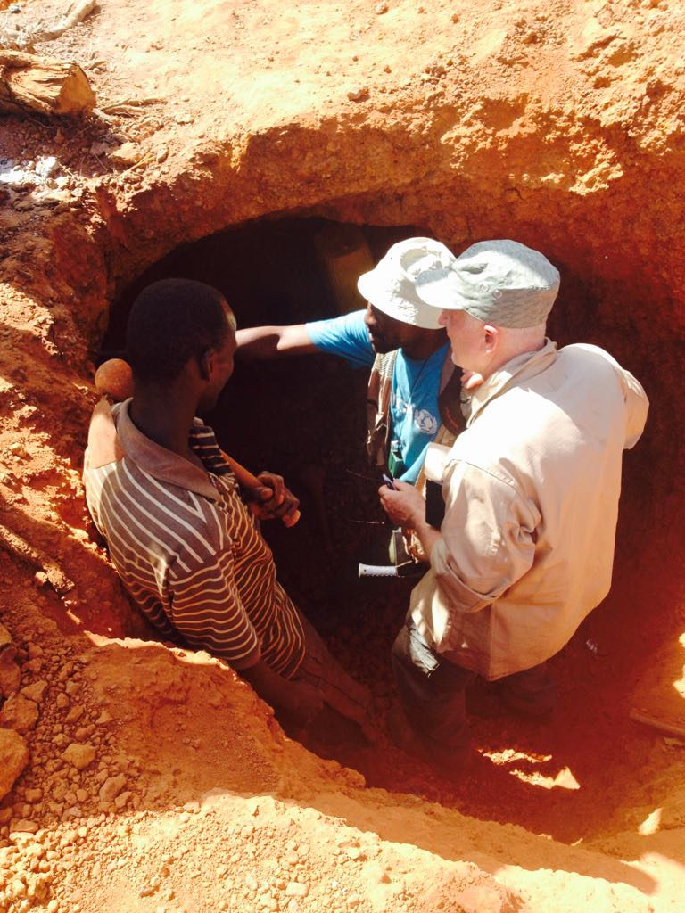
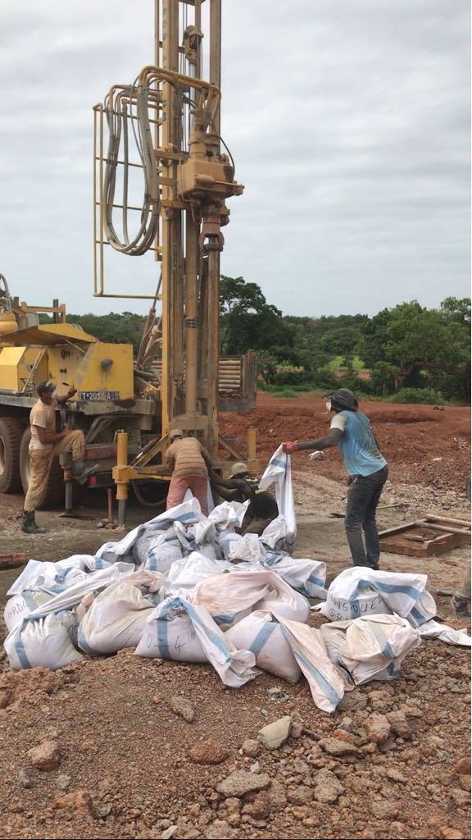
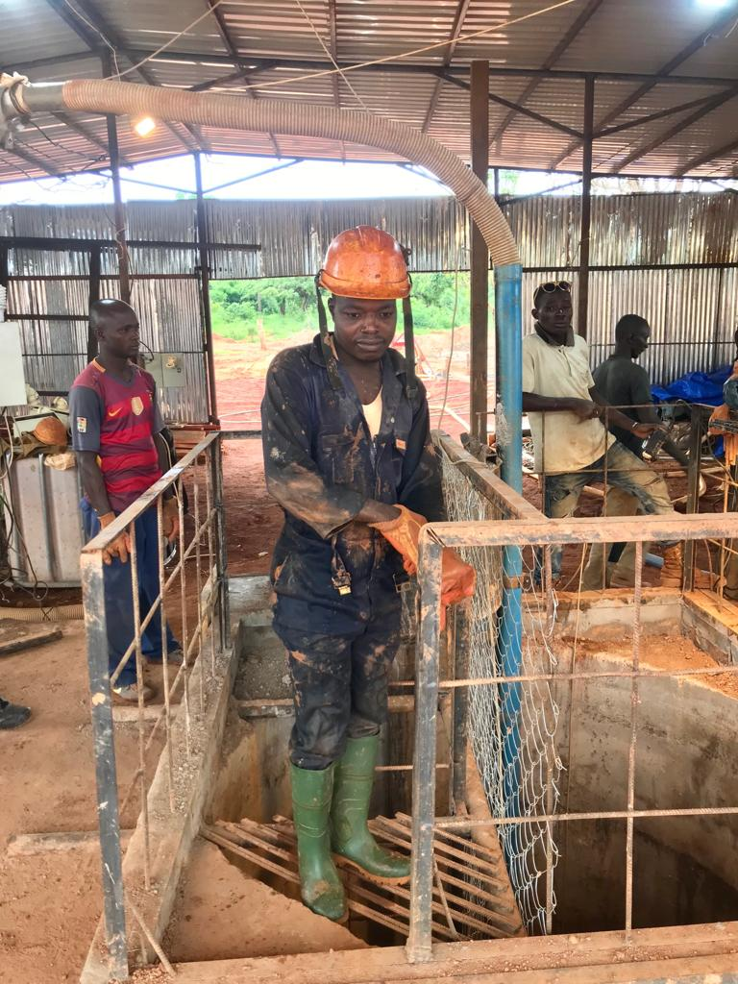
Brief history of Farafina
2012: Observation
2013 – 2017: Exploration
2018 – ?: Production

Slide 10
Farafina is actively integrating high technologies with deep local knowledge

Slide 11
Sustainable competitive advantage
Low entry costs
FGG is the first company in Guinea to leverage aerial mapping with Micromine modeling, surveying hundreds of kilometers and drastically reducing exploration costs
Operating leverage
Based on a blend of local expertise and cutting-edge technology: high-speed satellite Internet, remote-control management, physical analysis, aerial topography, image recognition software for mapping, laboratory complex for analysis of ore, 3D expert software 3D modeling software for open-pit construction and sub-surface shafts, interfacing with gold body dynamic models, etc.
Gold standard
As gold carries a negative discount rate, our future cash flows will be denominated in gold-linked units and not discounted. This practice will allow management and investors to better estimate the free cash flows derived from gold production and sales over the lifespan of the project.

Slide 12
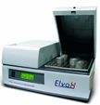
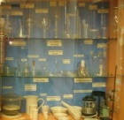
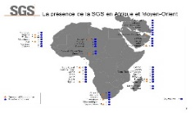
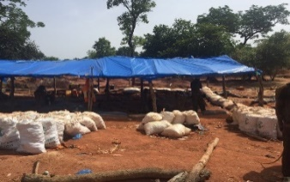
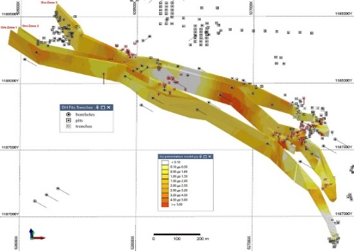
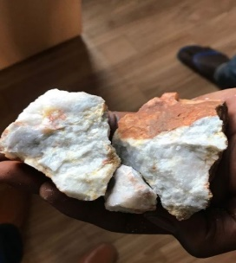
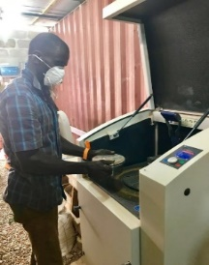
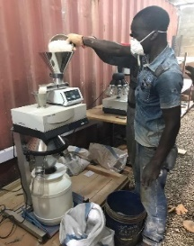
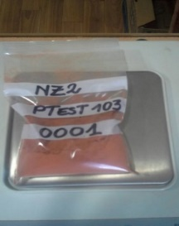
Farafina Exploration Model
Exploration
Local XRF and SGS analysis
Online ore body modelling
(Micromine software)
Sample preparation (Retch GMBH)

Slide 13
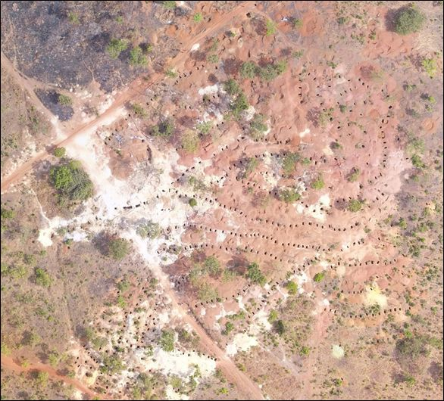
Geology
Location
The deposits are located within the West African craton, within the auriferous Siguiri basin of Birimian metasediments which contain gold mineralization.
Gold mineralization of the deposits is within quartz veins and vein zones of mineralization in meta-sedimentary rocks and weathering crusts.
Map

Slide 14
Mineral resources Nzima (3-D visualization)

Slide 15
Farafina estimated gold resources
 | Category | Tonnes (000s) | Grade (ppm) | Attributable Ounces (000s)
(Nzima), kOuz | Total | 8,856 | 2 | 553
(Kanguela East), kOuz | Total | 6,027 | 3.6 | 688
(Faralako North), kOuz | Total | 4,353 | 4.3 | 586
(Paramangui), kOuz | Total | 3,000 | 1 | 125
ALL | TOTAL | 22,236 | 1 | 1,952
and reserves
Site | Category | Tonnes (000s) | Grade (ppm) | Attributable Ounces (000s)
Nzima | Probable | 1,116 | 2 | 77
Kanguela | Proved and Probable | 16 | 44 | 48
 | TOTAL | 1453 | 2.68 | 125

Slide 16
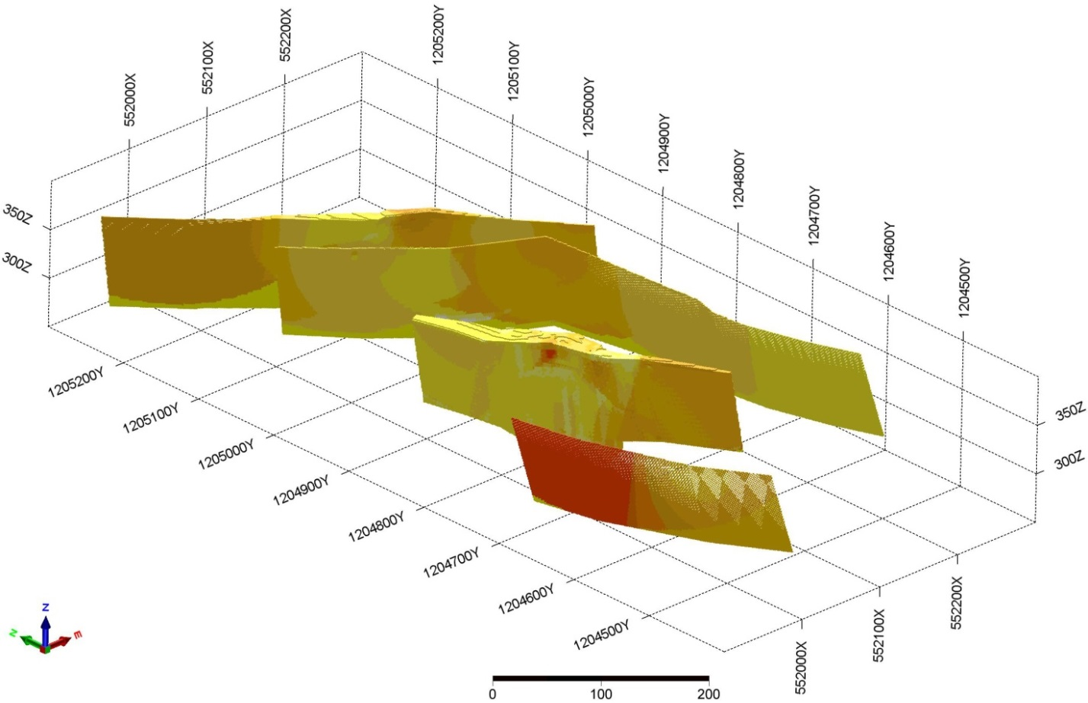
Mineral resources Wodokodoni (3-D visualization)

Slide 17
FGG represents one of the most dynamic investment opportunities in Western Africa

Slide 18
Farafina Gold Group is a rare investment opportunity
Management is seeking to raise up to $10 million in debt and/or equity financing to develop its two flagship properties
ROE may exceed 300% within several years

Slide 19
Return on investment model
License area | Nzima | Kanguela
Content of gold in mine ore, g/ton | 2.5 | 2.5
Extraction coefficient | 0.8 | 0.8
NPV of the project in 48 months, at the price of 1 300 USD/Oz | 10,000 | 27,000
Projected Return on Equity | 202% | 311%
Payback period, months | 34 | 16

Slide 20
Projected equity value Farafina Gold Group

Slide 21
Implementation timeline
Q4 2019
Obtain 2nd mining license
Work on fundraising
Q1 2020
Raise $1 mm minimum
Deploy at the mining sites
Q2 2020
Complete private offering / STO
Commence production
Commence platform development for STO
Lay the mouths of the first shafts
Pass vertical trunks
Lay horizontal drifts
Commence production
Conduct additional geological exploration work to increase reserves
Q3 2020 – Q4 2020
Lay additional mines
Continue geological surveys (with expected increase in proven reserves to be about 100%)
Q4 2020 - Q4 2022
Realized 90% of production capacity
Finalize infrastructure deployment
Start of shaft production

Slide 22
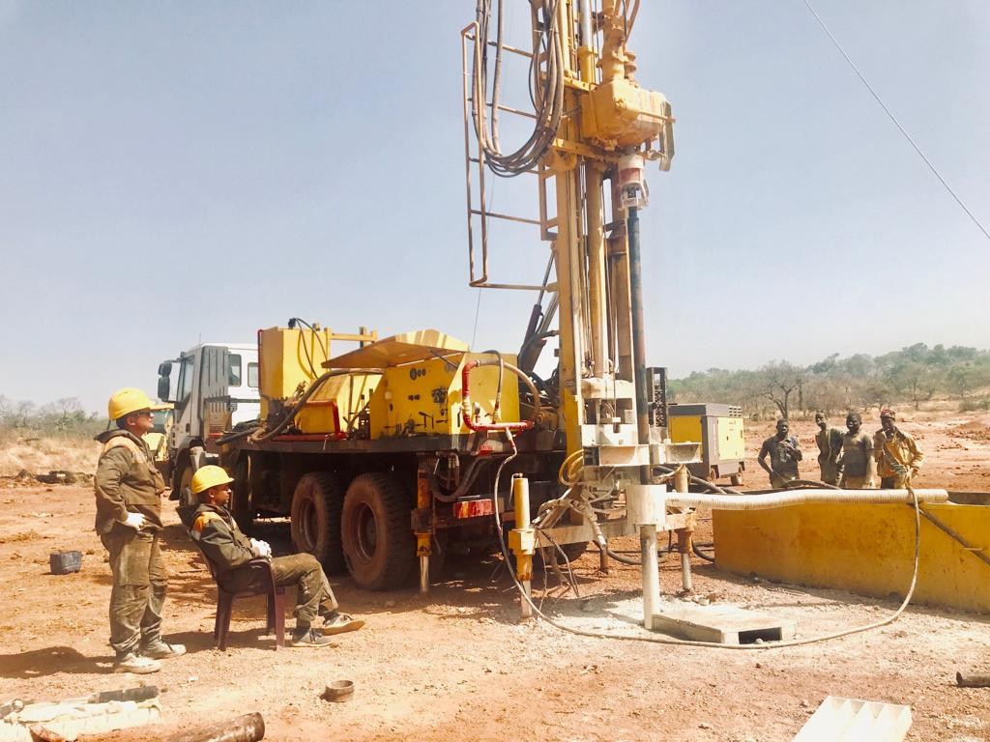
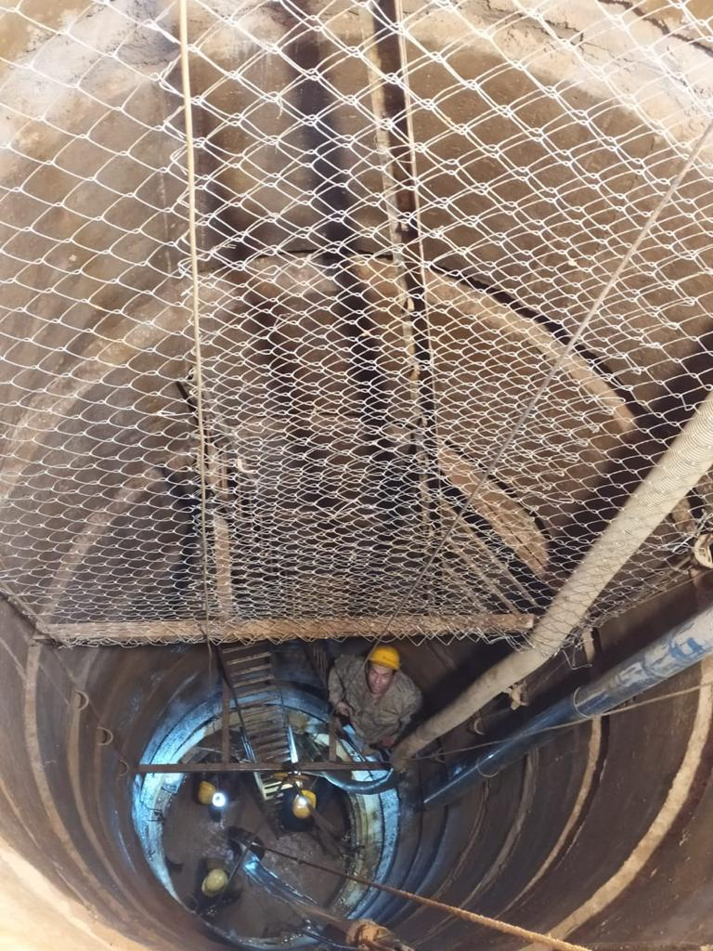
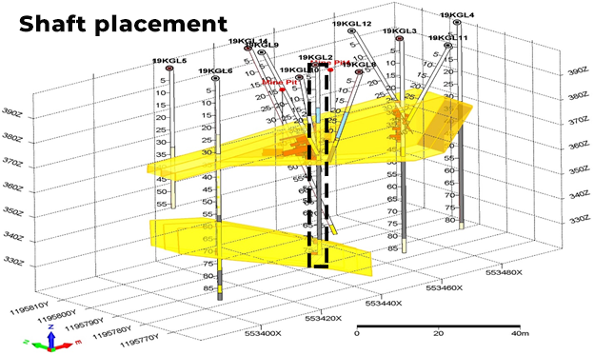
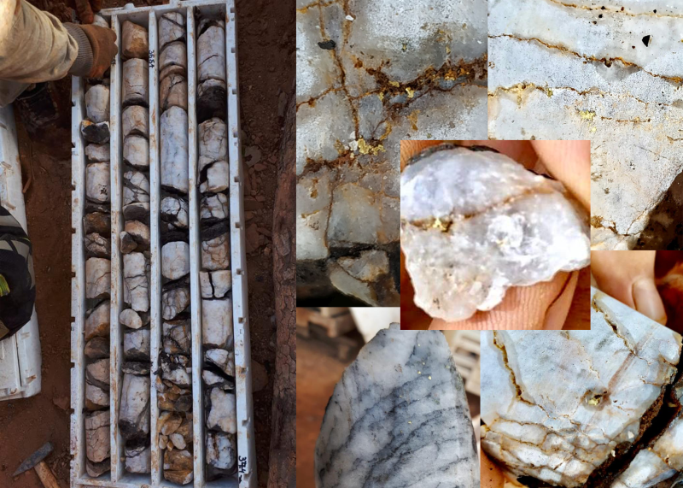
2019 – start of shaft production
=

Slide 23
Our team is our most valuable asset

Slide 24
Building a community together

Slide 25
Extraction of gold from ore

Slide 26
Descending into the first underground shaft in Guinea

Slide 27
Real-time modeling

Slide 28
Welcome to Farafina Village

Slide 29
THANK YOU FOR YOUR ATTENTION! info@farafina.biz www.farafina.biz

